Slide 1
Hack the Box Invite Code Challenge - Before we begin
Some Ground Rules…
This is supposed to be fun - if you have questions and want to go off on tangents, lets do it
Things WILL go wrong - please be patient
There is more than one way to skin a cat – This is only one way to solve the challenge
This is supposed to be fun!
Supported by
Proud Supporters of

Slide 2
Hack the Box Invite Code Challenge – Lets Go
Open a web browser and
go to https://www.hackthebox.eu
Supported by
Proud Supporters of

Slide 3
Find the challenge…
Click
Scroll down
and click join
Supported by
Proud Supporters of

Slide 4
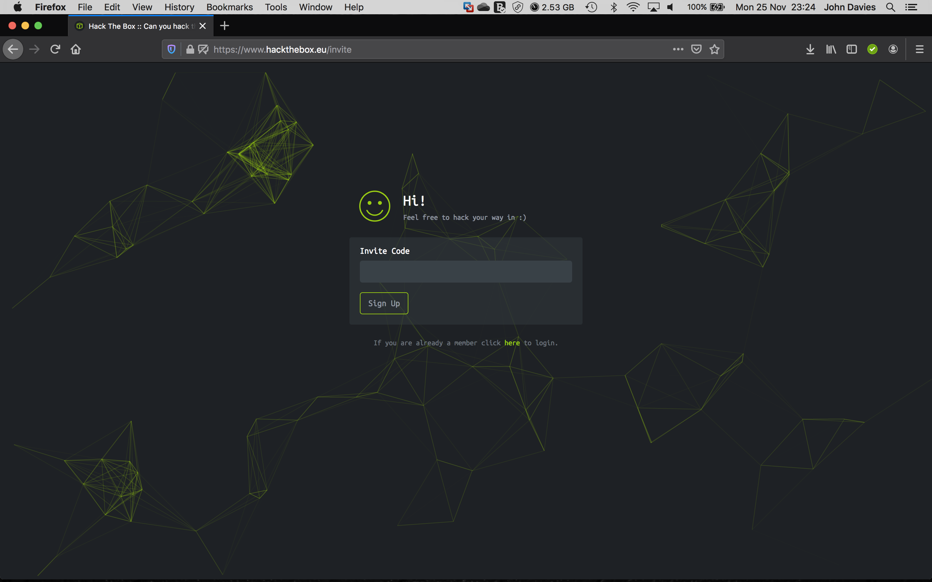
…and so it begins…
What do we know?
Where do we begin?
Supported by
Proud Supporters of

Slide 5
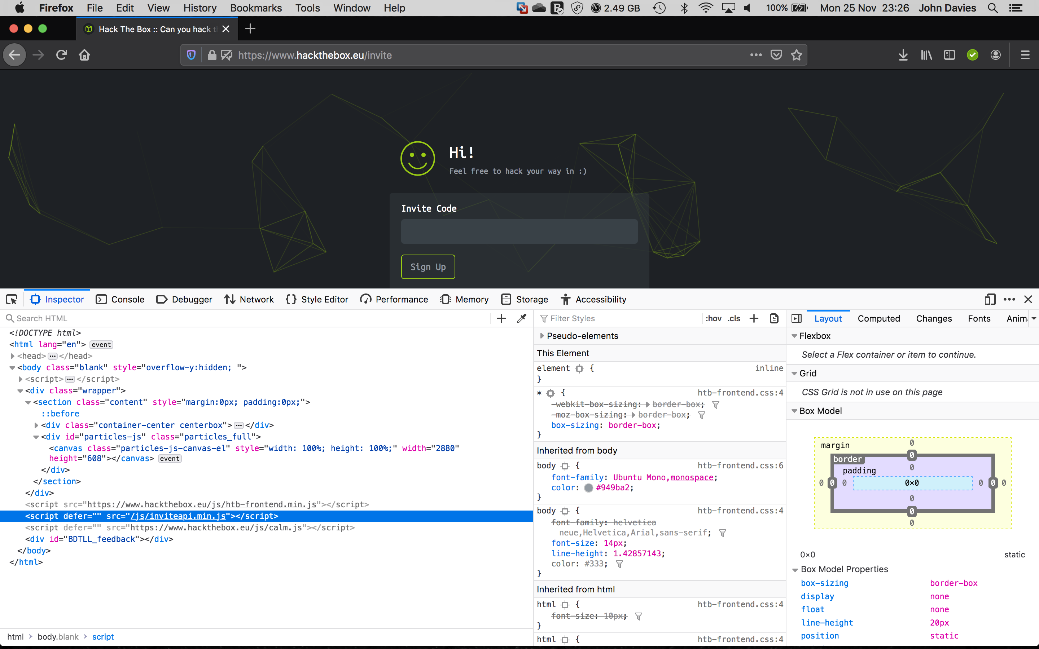
Are there any clues in the code?
Supported by
Proud Supporters of

Slide 6
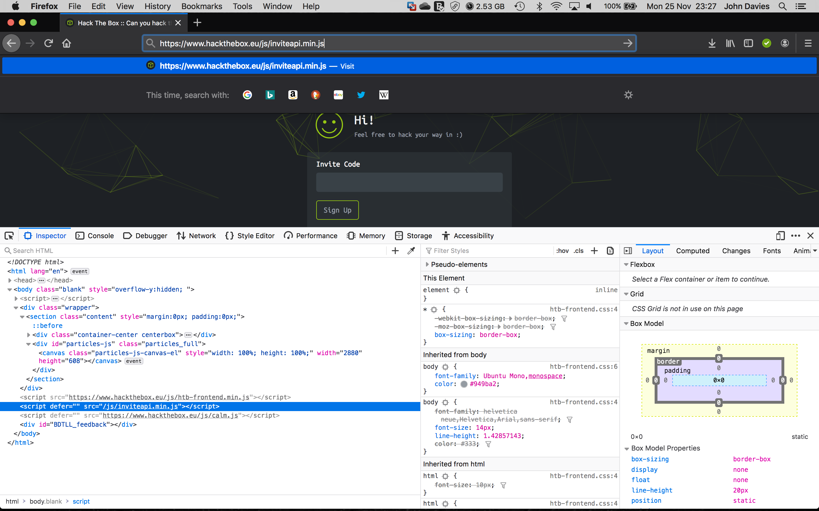
inviteapi.min.js looks interesting… Lets take a look…
Put the script address in the
address bar to load it directly
Supported by
Proud Supporters of

Slide 7
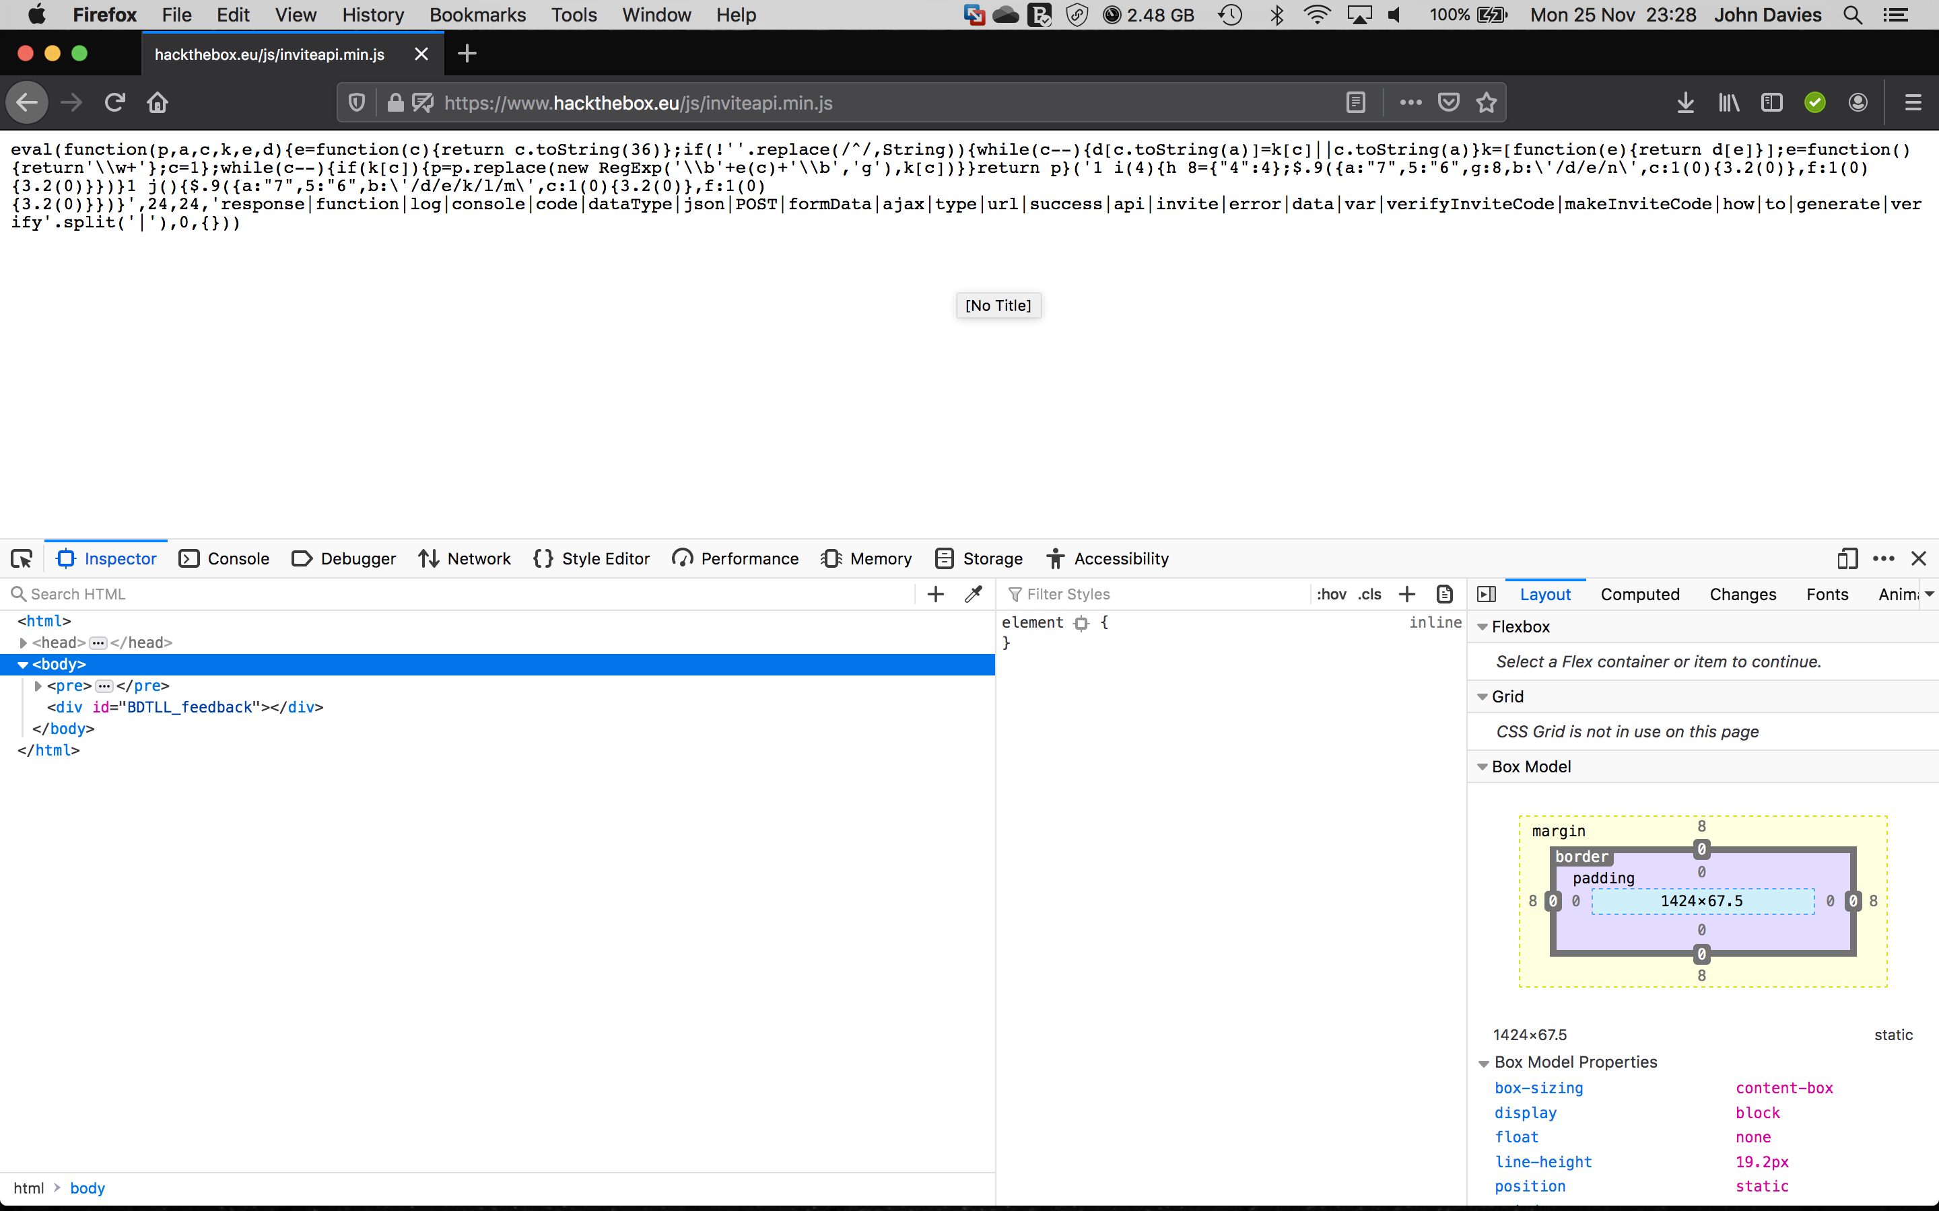
Looks like this JavaScript is minimized and obfuscated
Let’s see if we can make some sense
of this code
Copy all of this gibberish and open a new tab
Supported by
Proud Supporters of

Slide 8
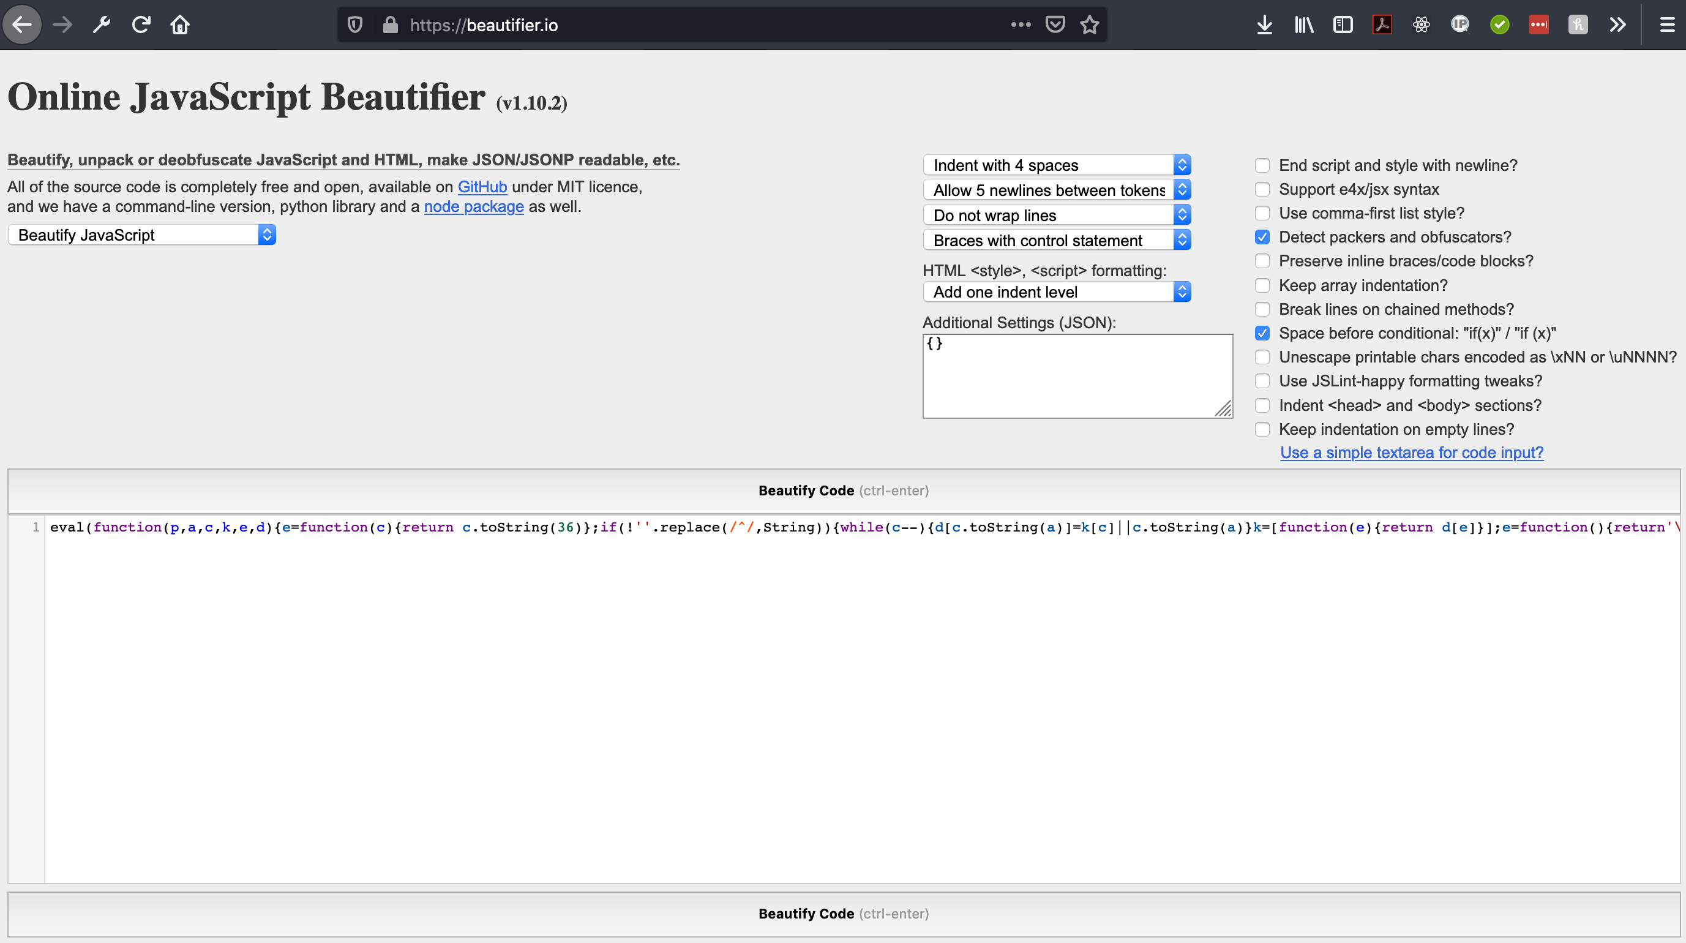
Let’s see if we can make some sense of it
Got to https://beautifier.io
Paste the gibberish (encoded script) in here
Click Beautify Code
Supported by
Proud Supporters of

Slide 9
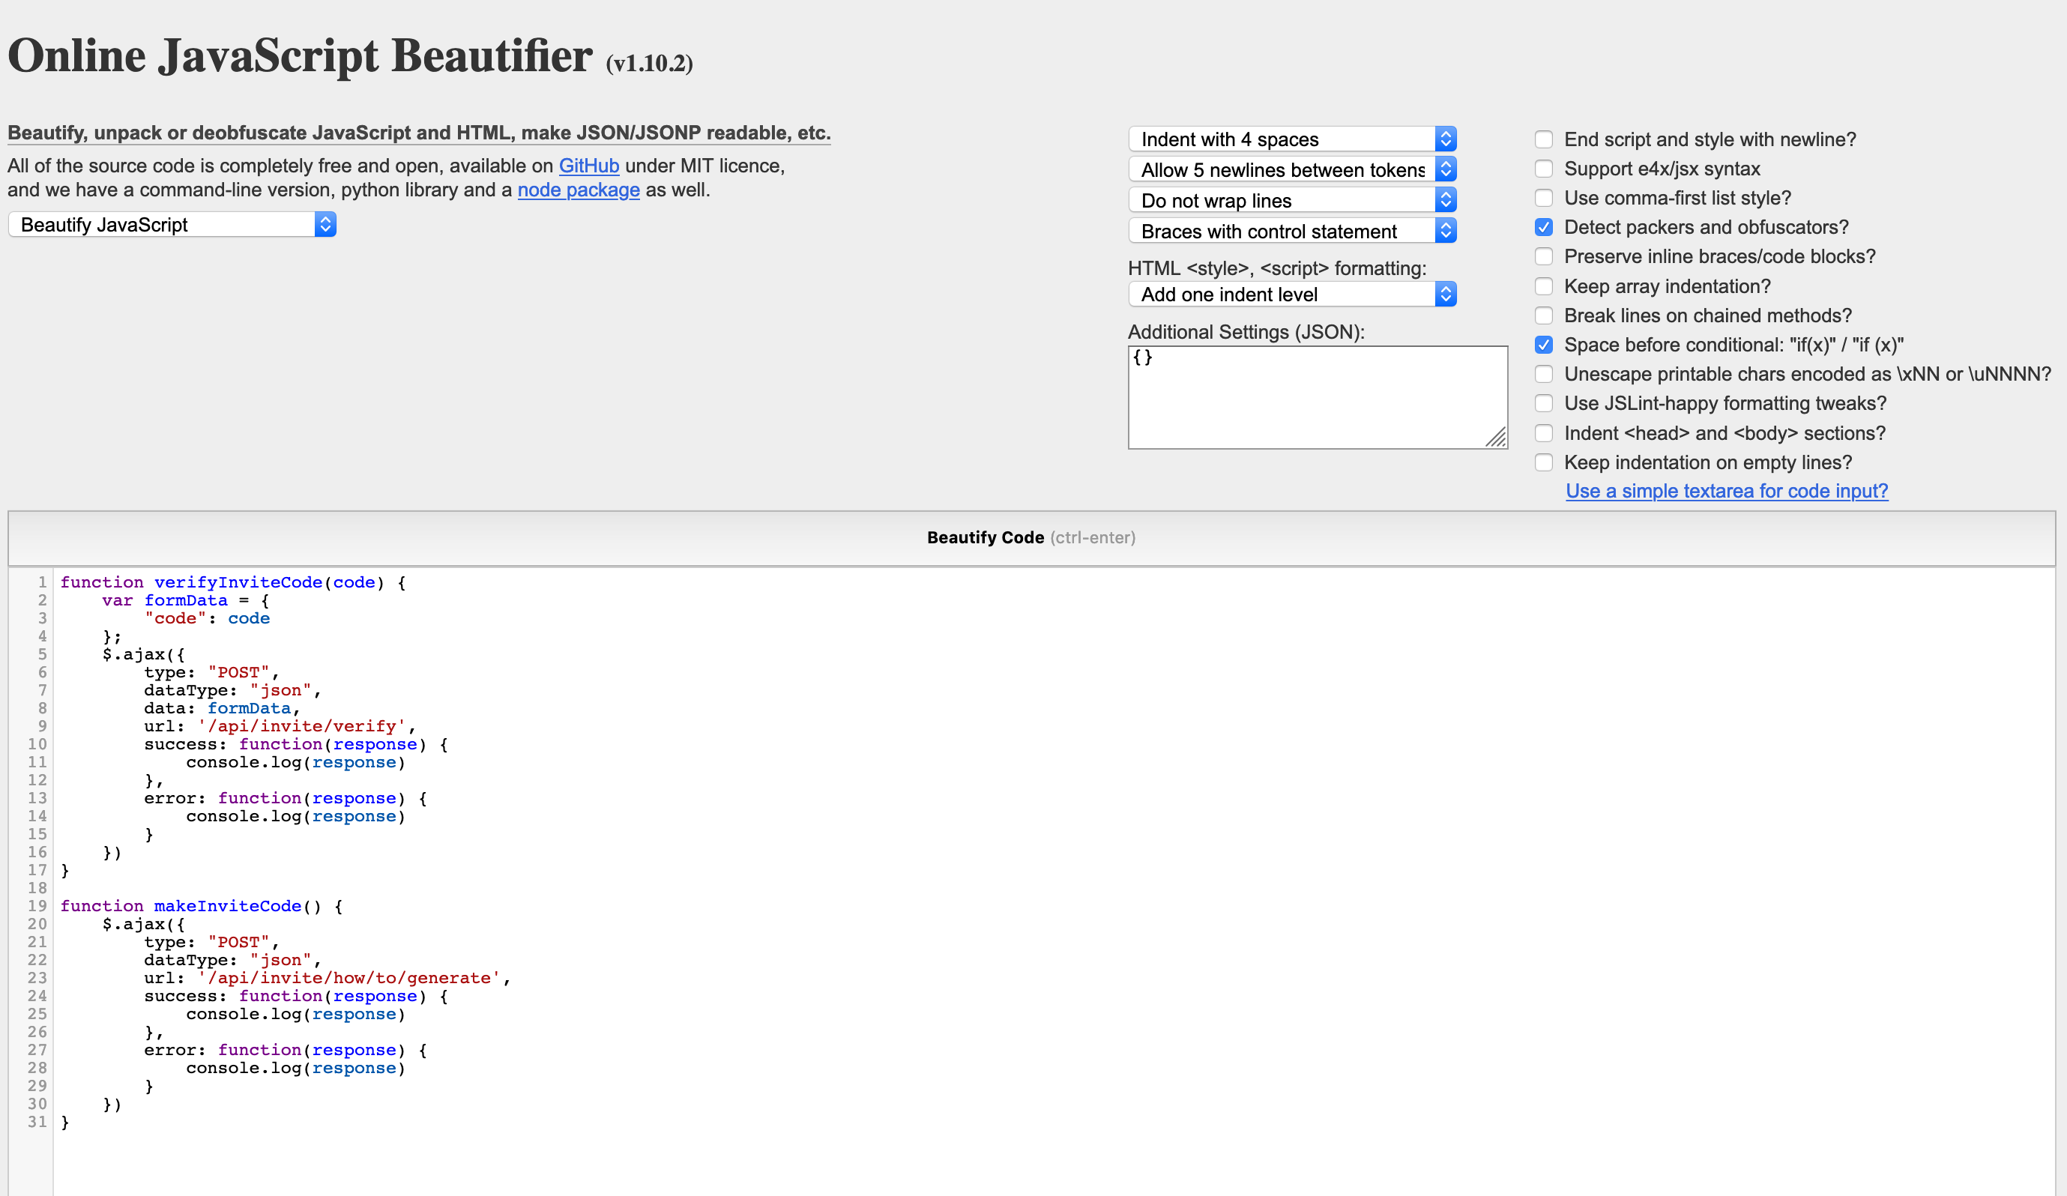
Let’s see if we can make some sense of it
We can now see that this script contains 2 functions
verifyInviteCode(code)
makeInviteCode()
One of these functions looks pretty useful.
Let’s see what it does
Supported by
Proud Supporters of

Slide 10
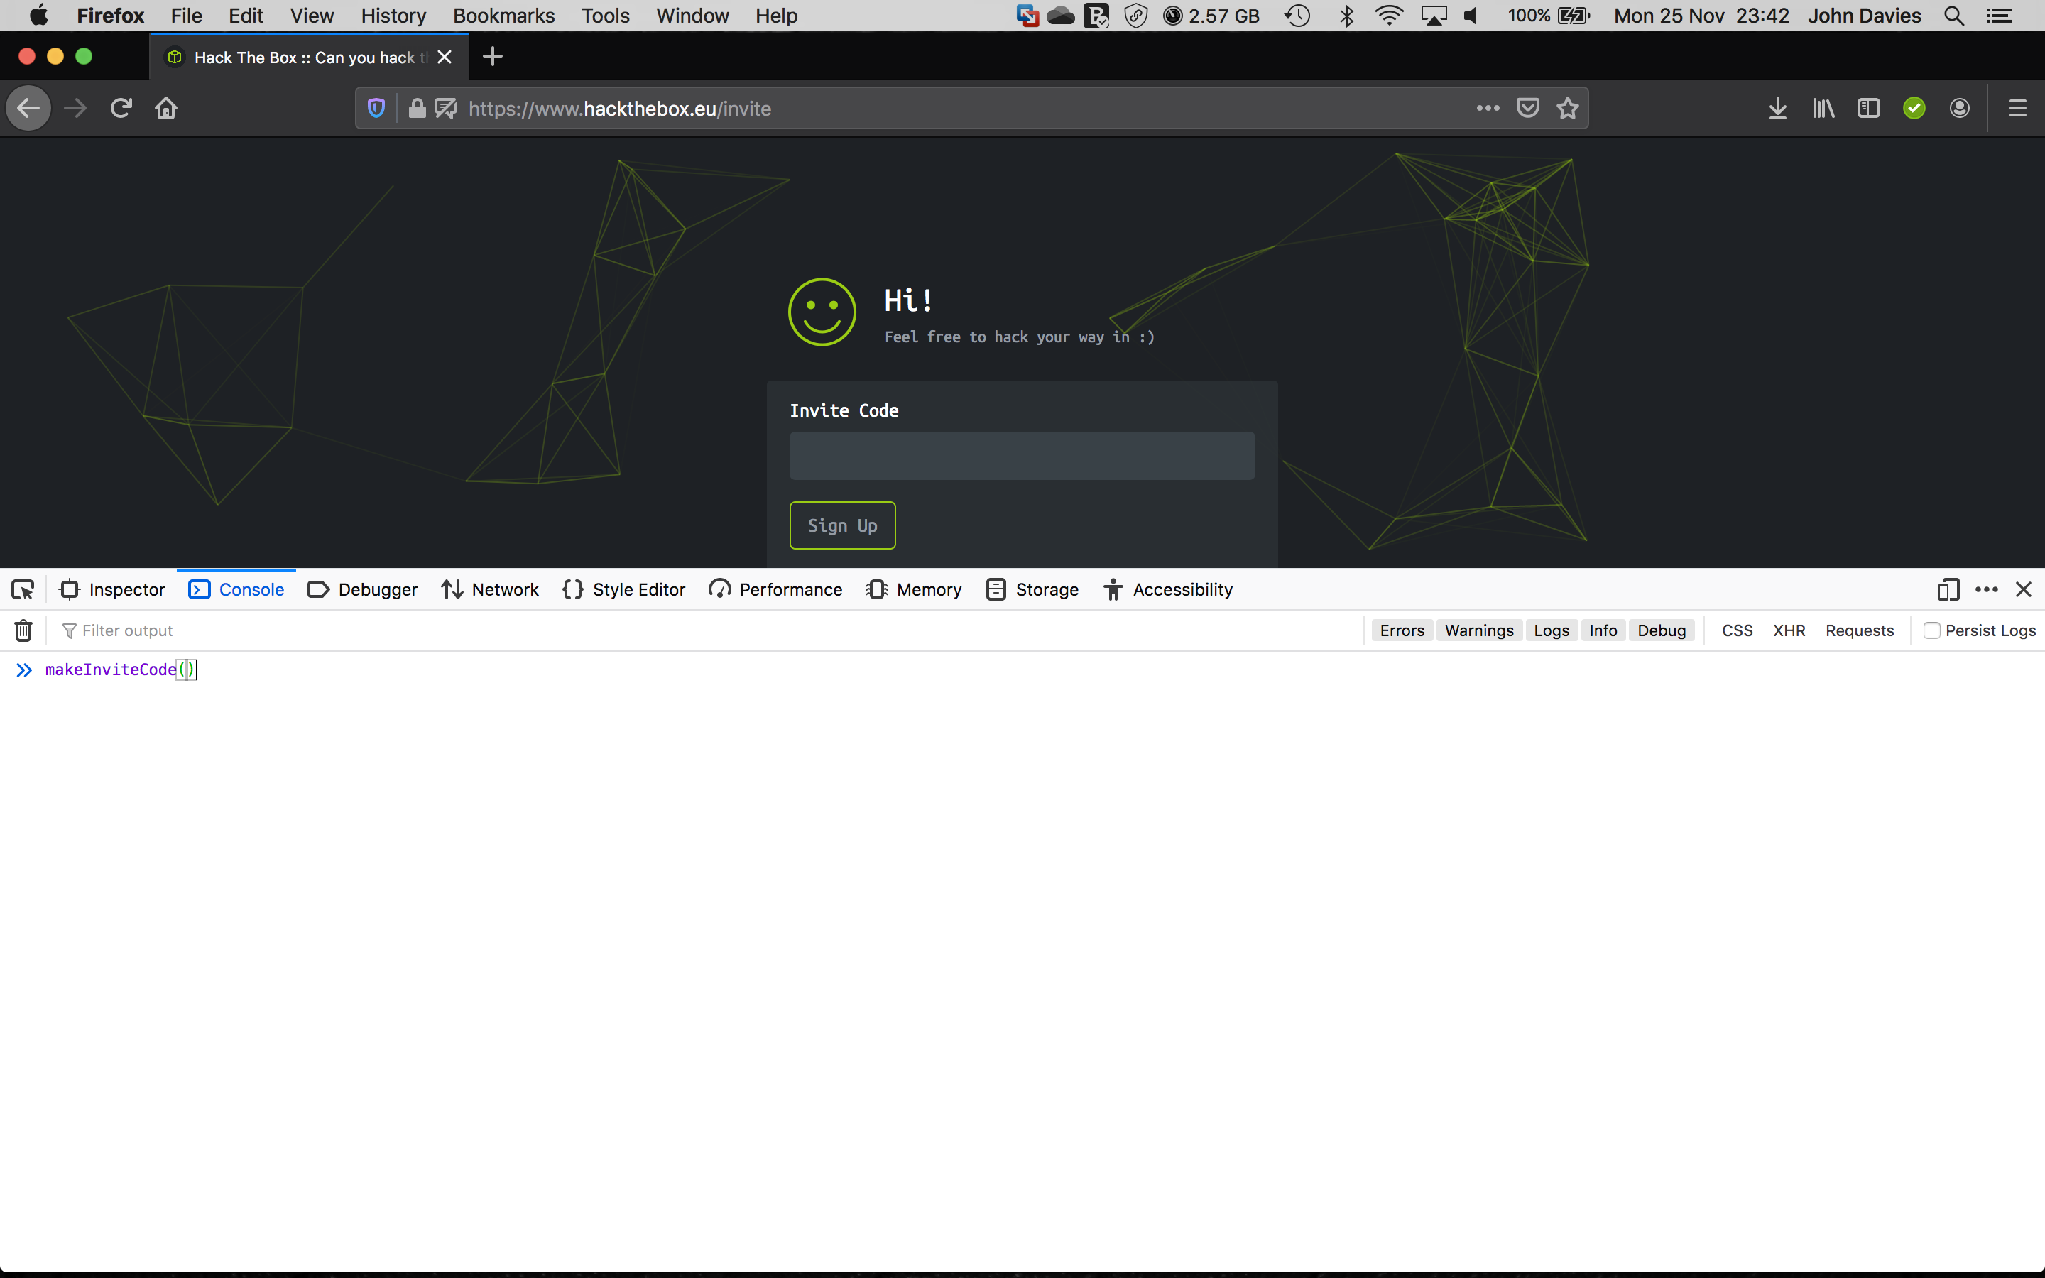
Let’s try calling that and see what happens
Go back to the invite code challenge
Page and open the developer tools
again (right click and select ‘inspect
Element’ or press F12)
This time, select the ‘Console’ tab.
We can now call the function that we identified
directly as if the webpage was calling it by typing
makeInviteCode()
in the console and pressing ‘enter’
Supported by
Proud Supporters of

Slide 11
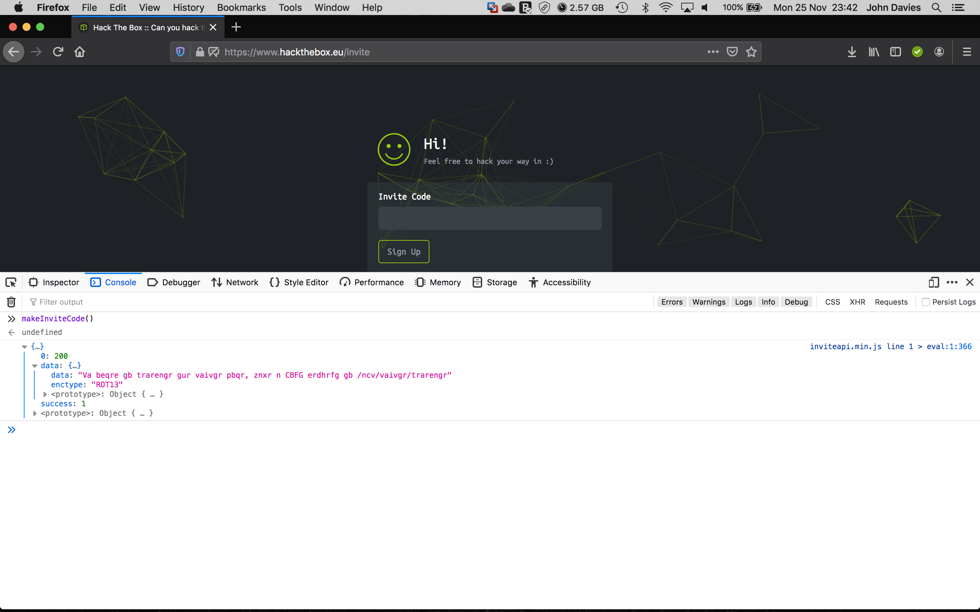
Well that’s a chatty function, what’s it saying?
We can see the data payload
They have also provided the encryption
type for us, but what is ROT13?
Sometimes you will also see ‘BASE64’
As the encryption type
Supported by
Proud Supporters of

Slide 12
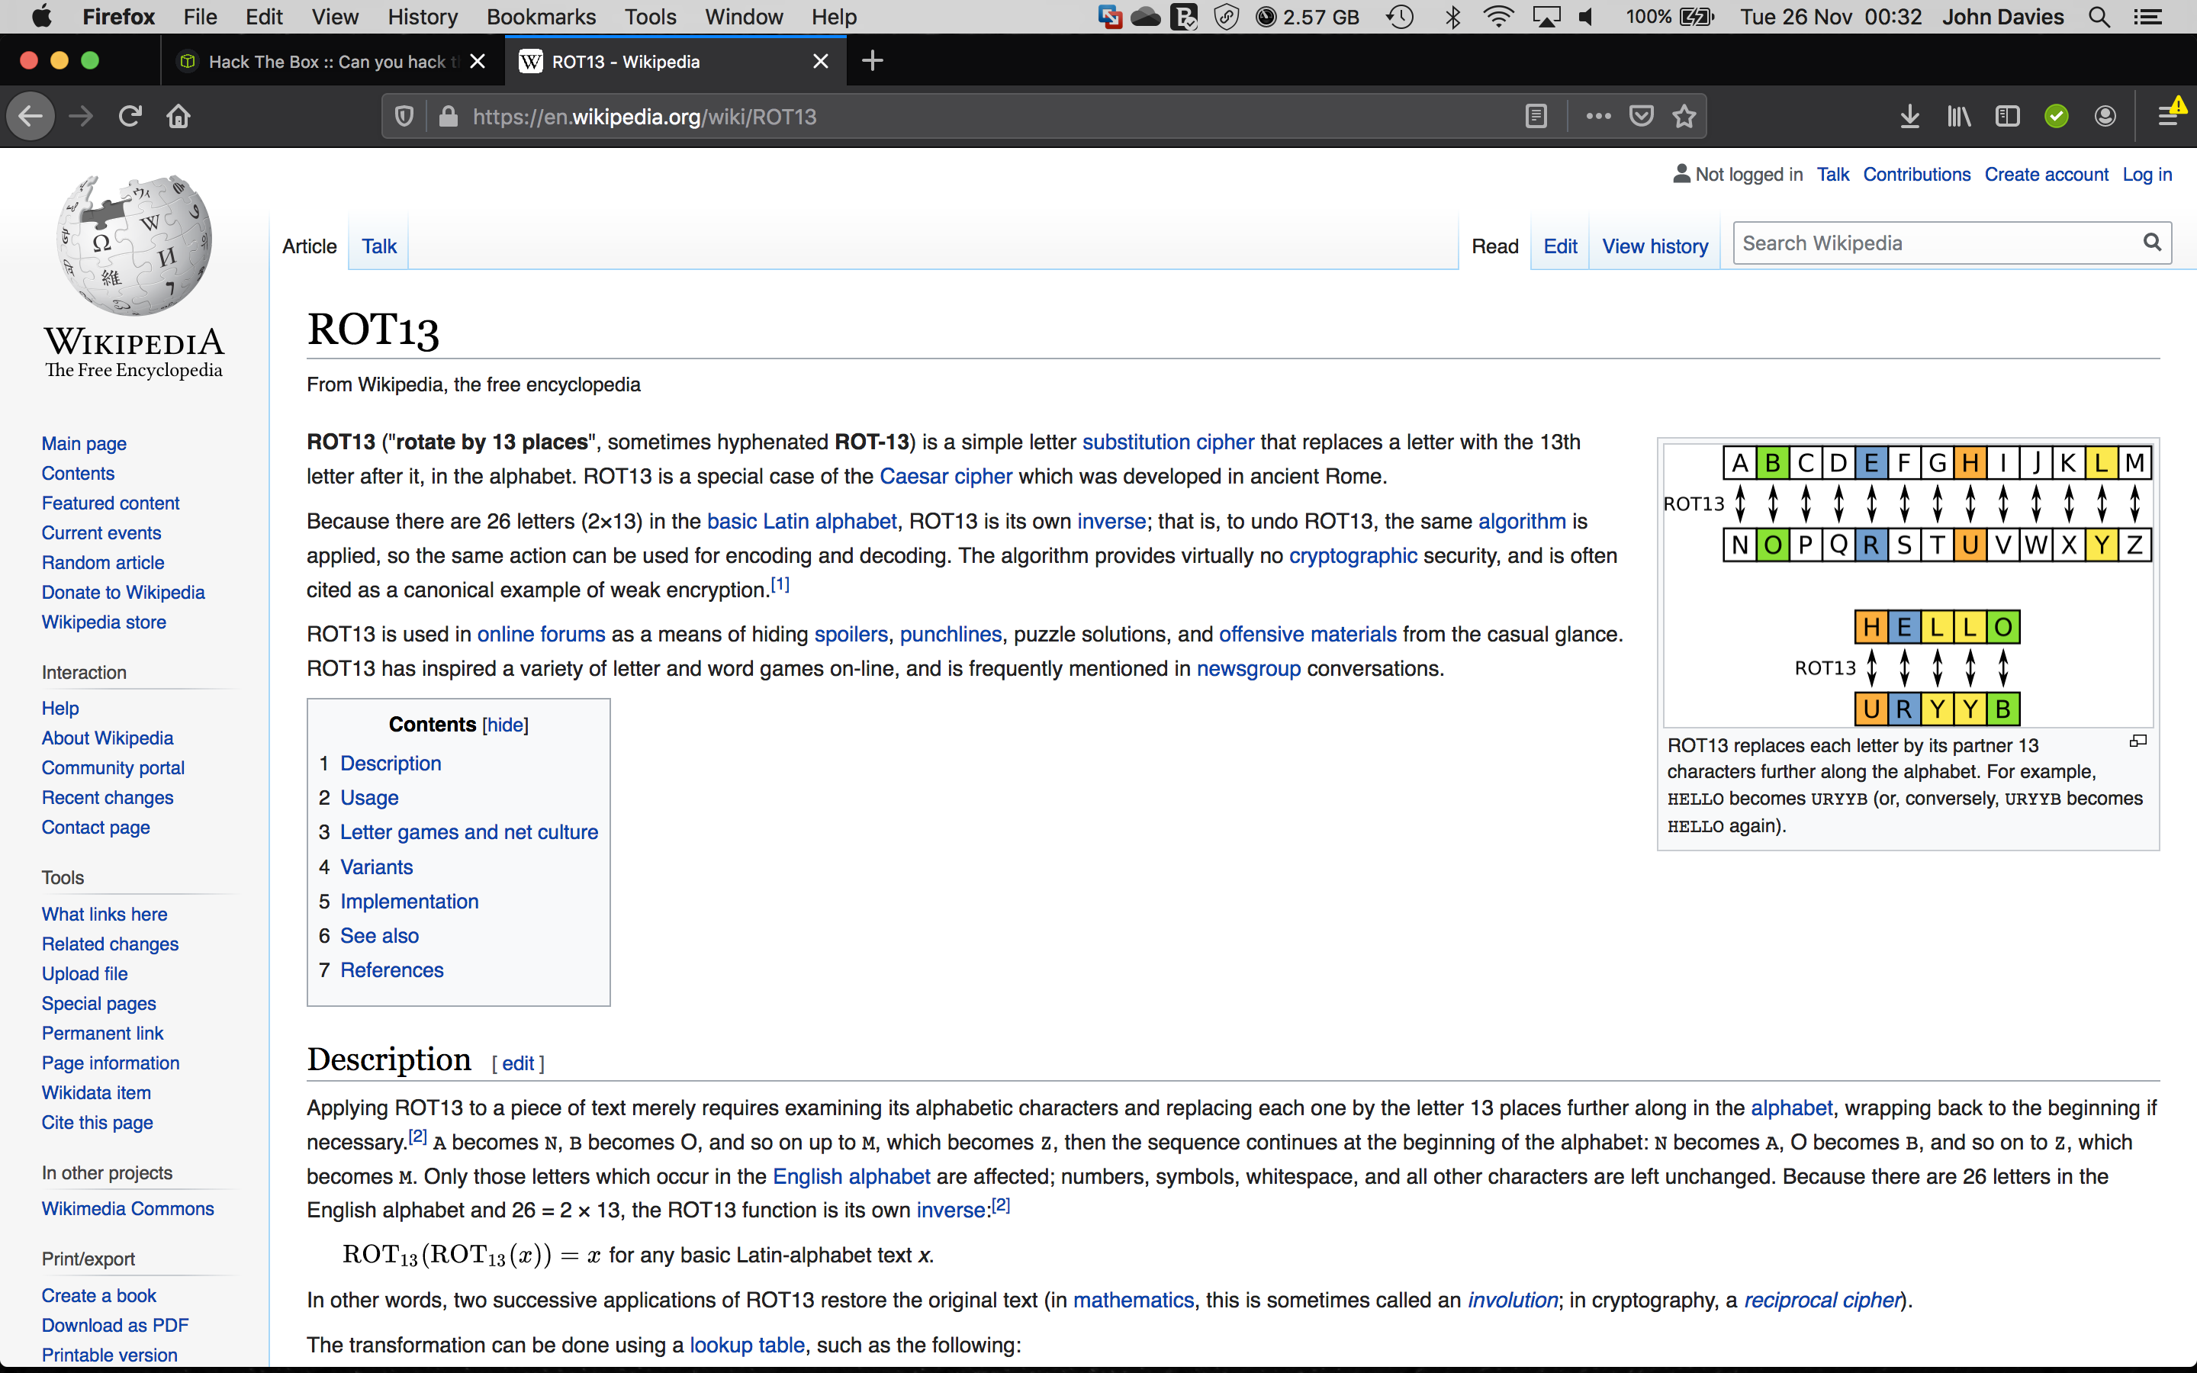
I love treason but hate a traitor – Julius Caesar
Supported by
Proud Supporters of

Slide 13
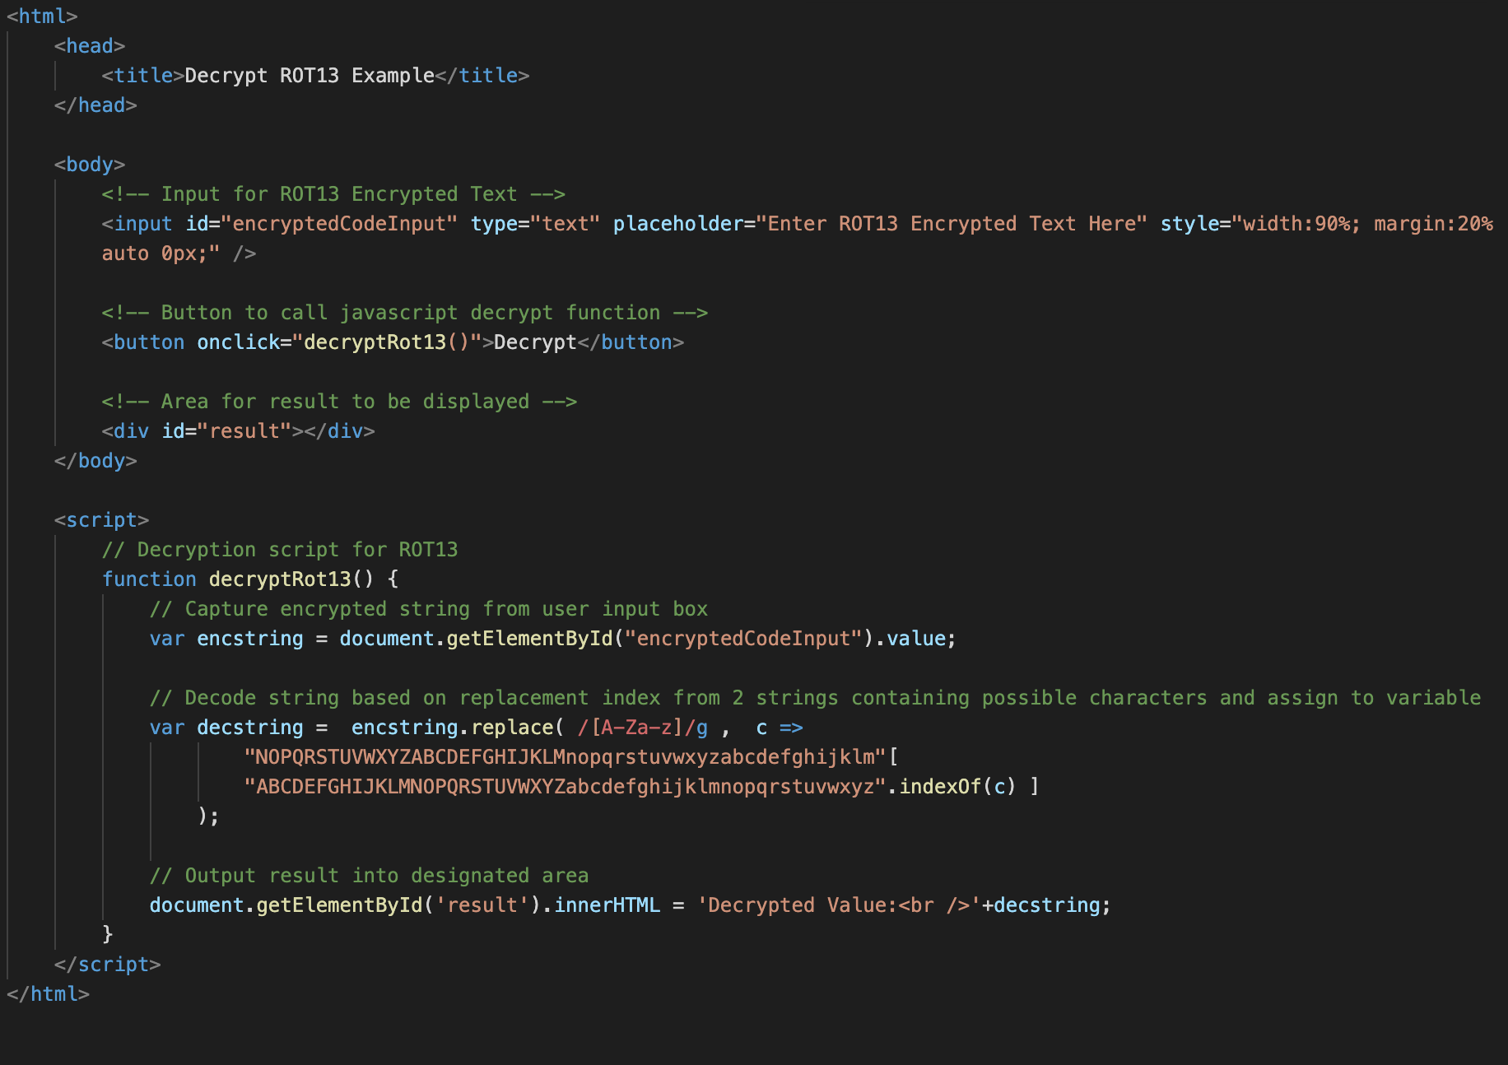
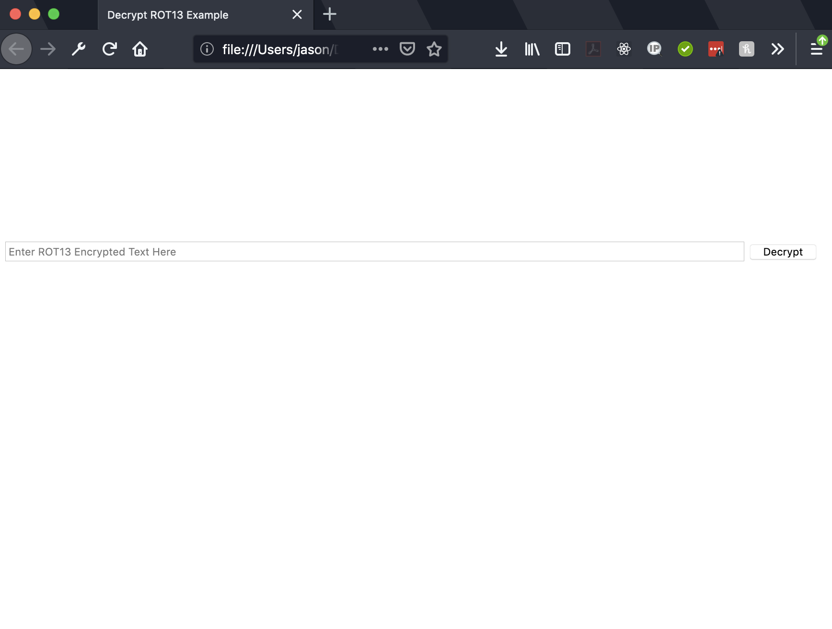
Decrypting ROT13
One answer is to build our own decryptor… Here is an example as a web page
Supported by
Proud Supporters of

Slide 14
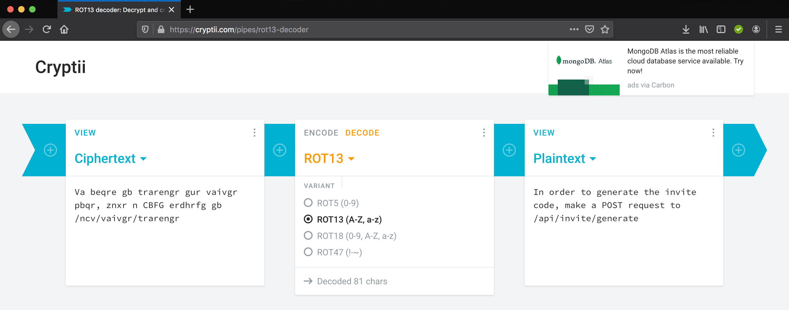
Why make it hard for ourselves?
Supported by
Proud Supporters of

Slide 15
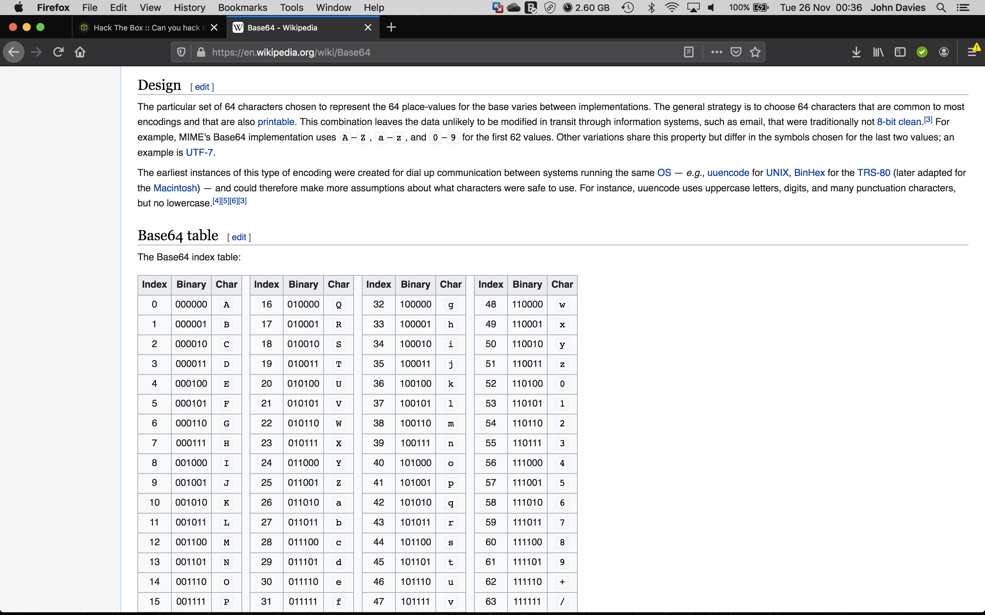
What is Base64?
Supported by
Proud Supporters of

Slide 16
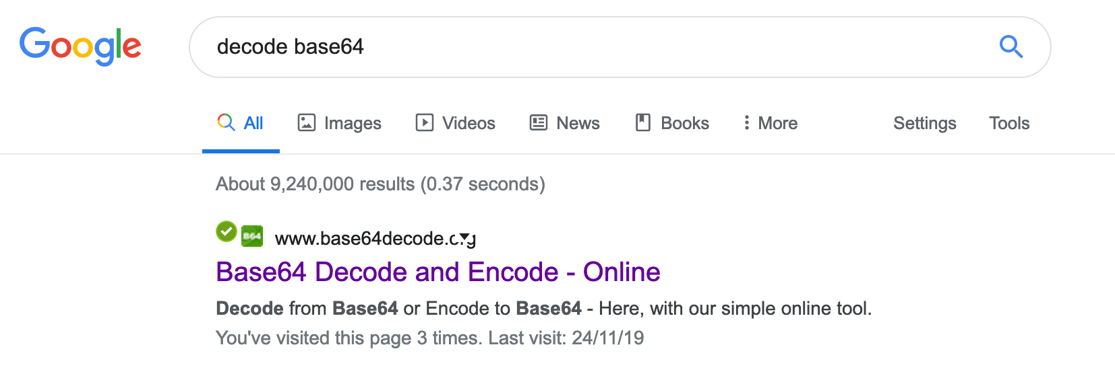
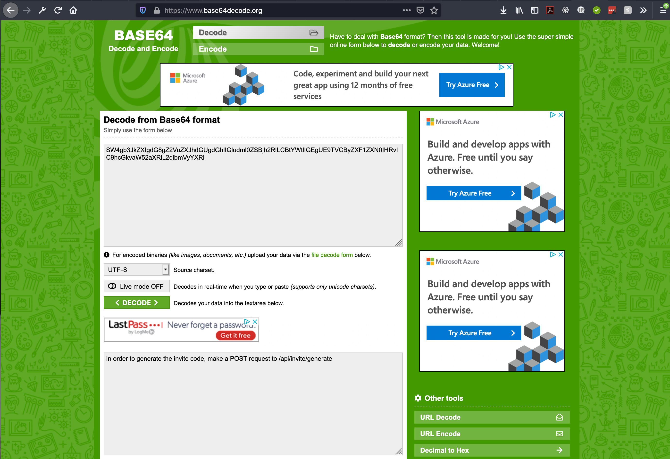
Still no need to reinvent the wheel
Supported by
Proud Supporters of

Slide 17
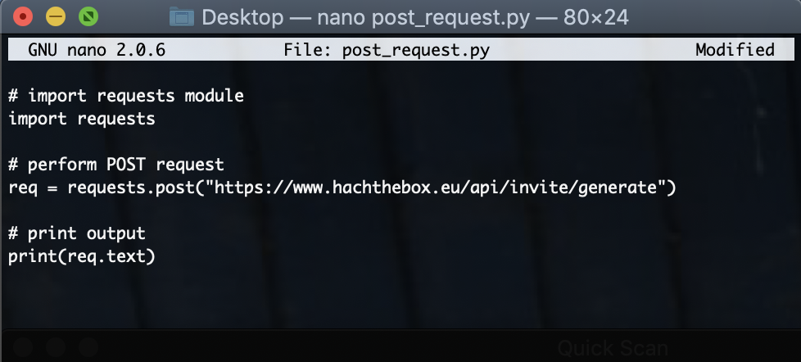
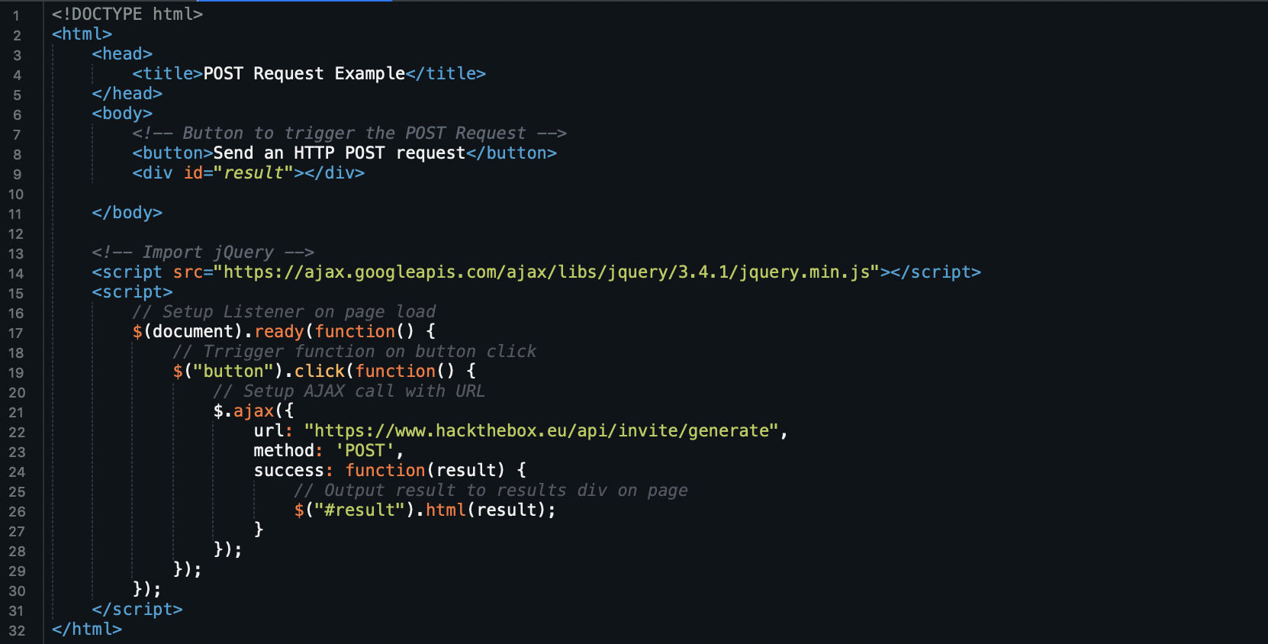
Making a POST request
Do it in the command line if you have tools installed
curl -X POST https://www.hackthebox.eu/api/invite/generate
Write a custom script in your choice of language
There are also browser plugins available
Supported by
Proud Supporters of

Slide 18
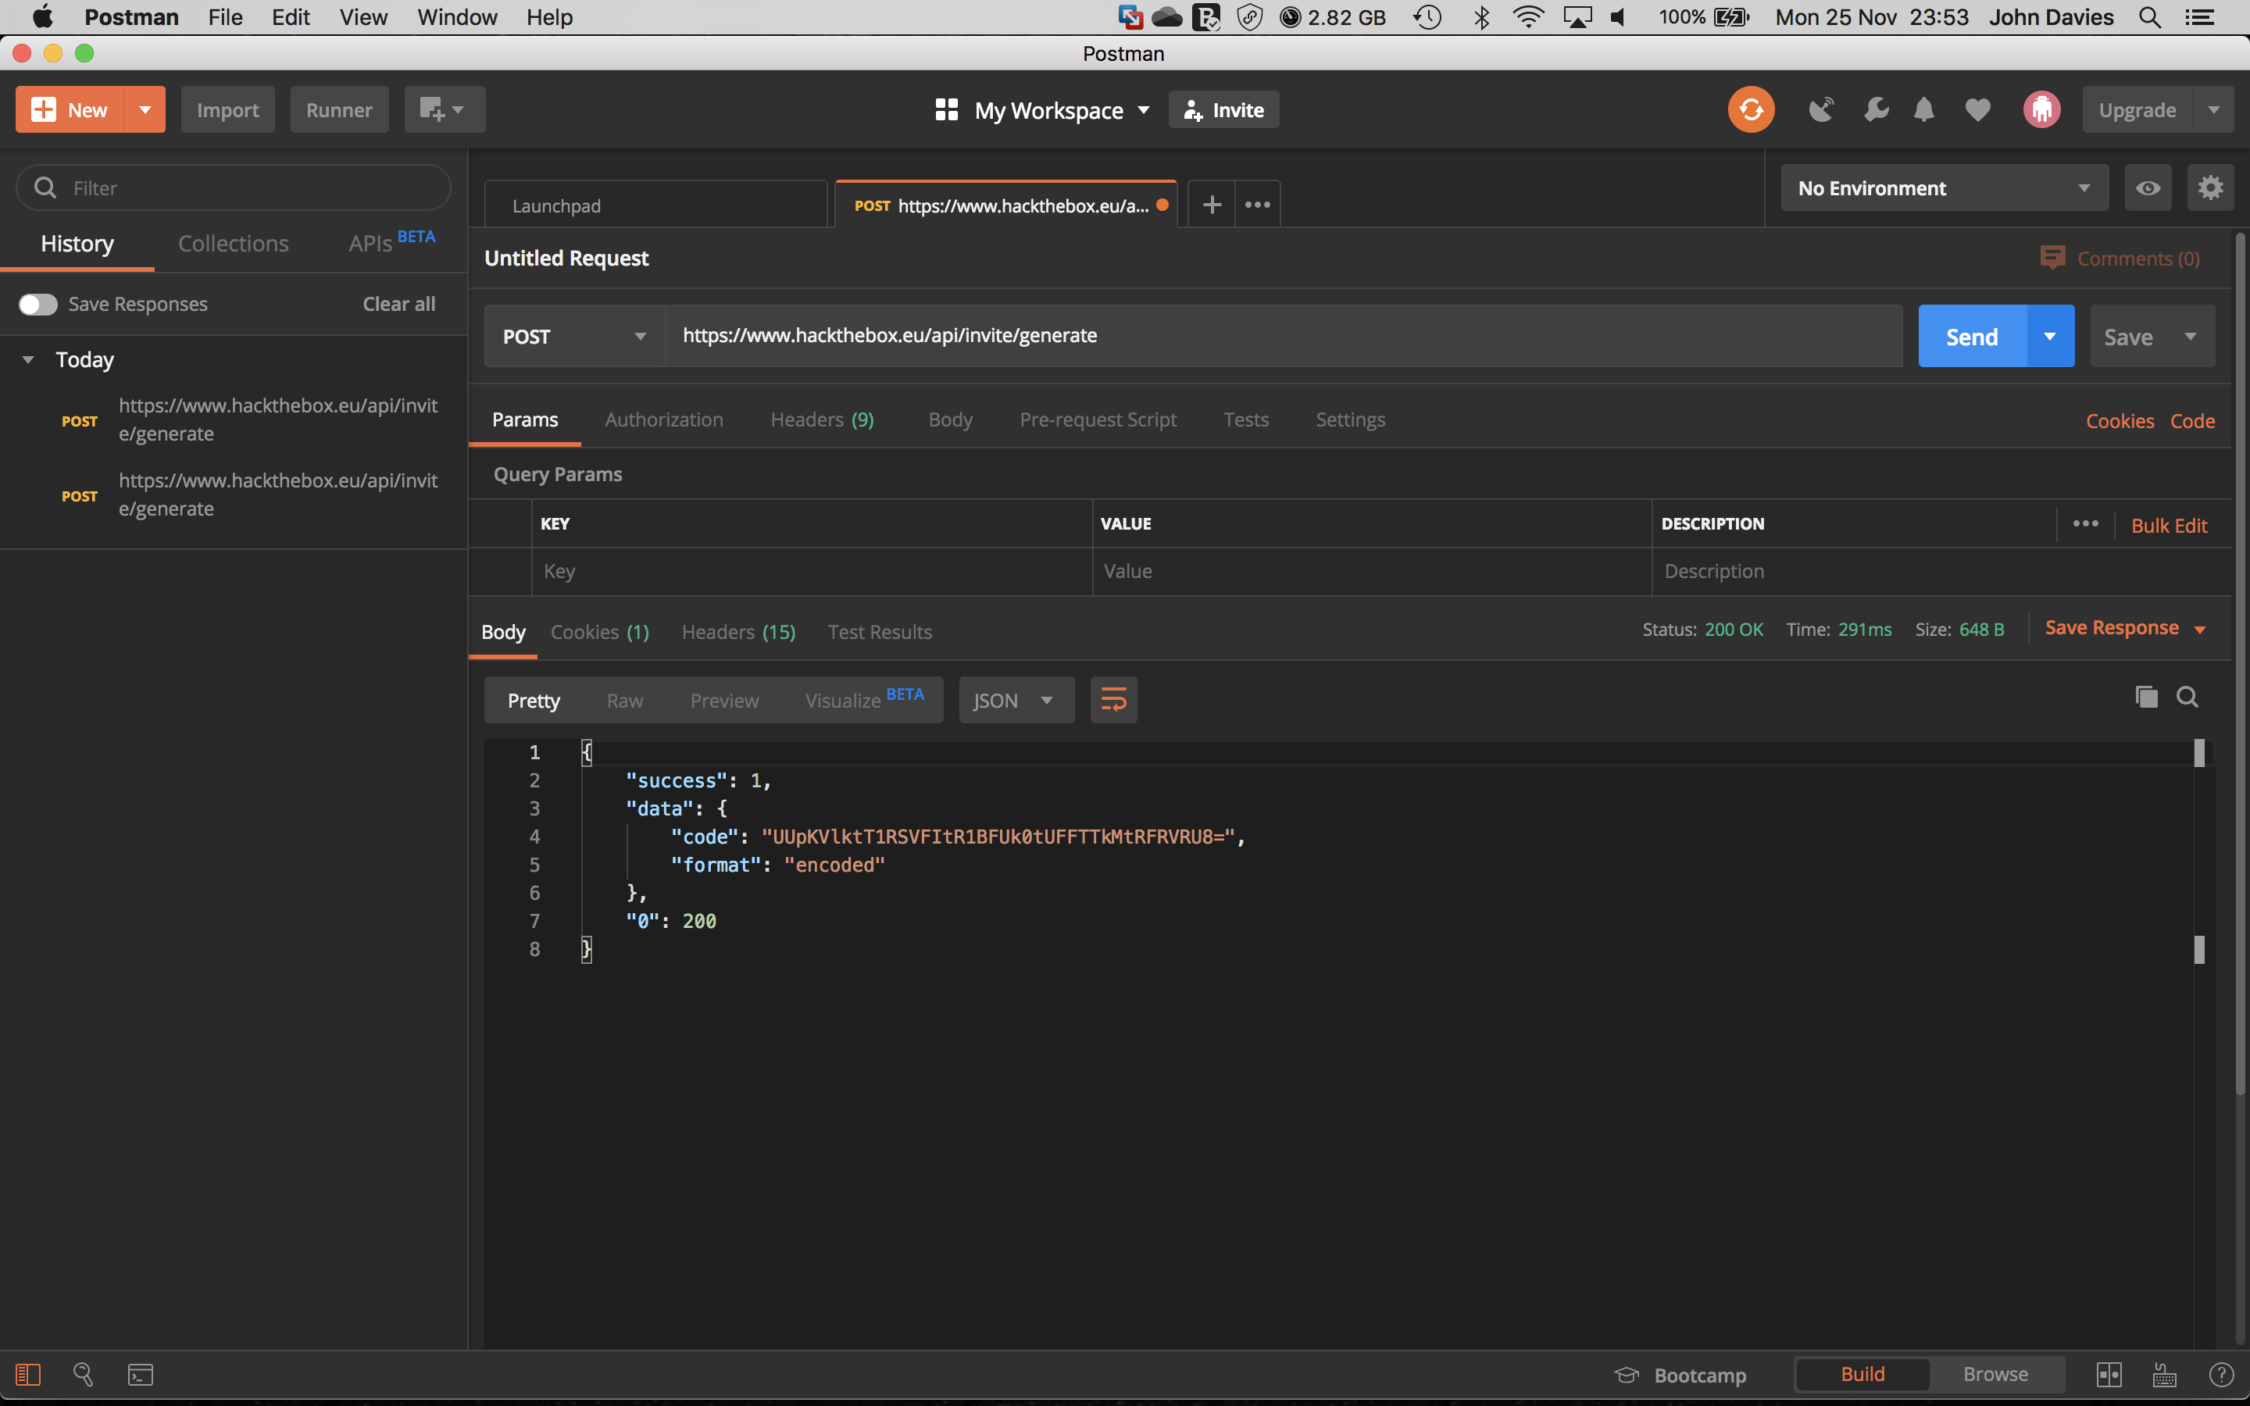
There is an easy way here too
Supported by
Proud Supporters of

Slide 19
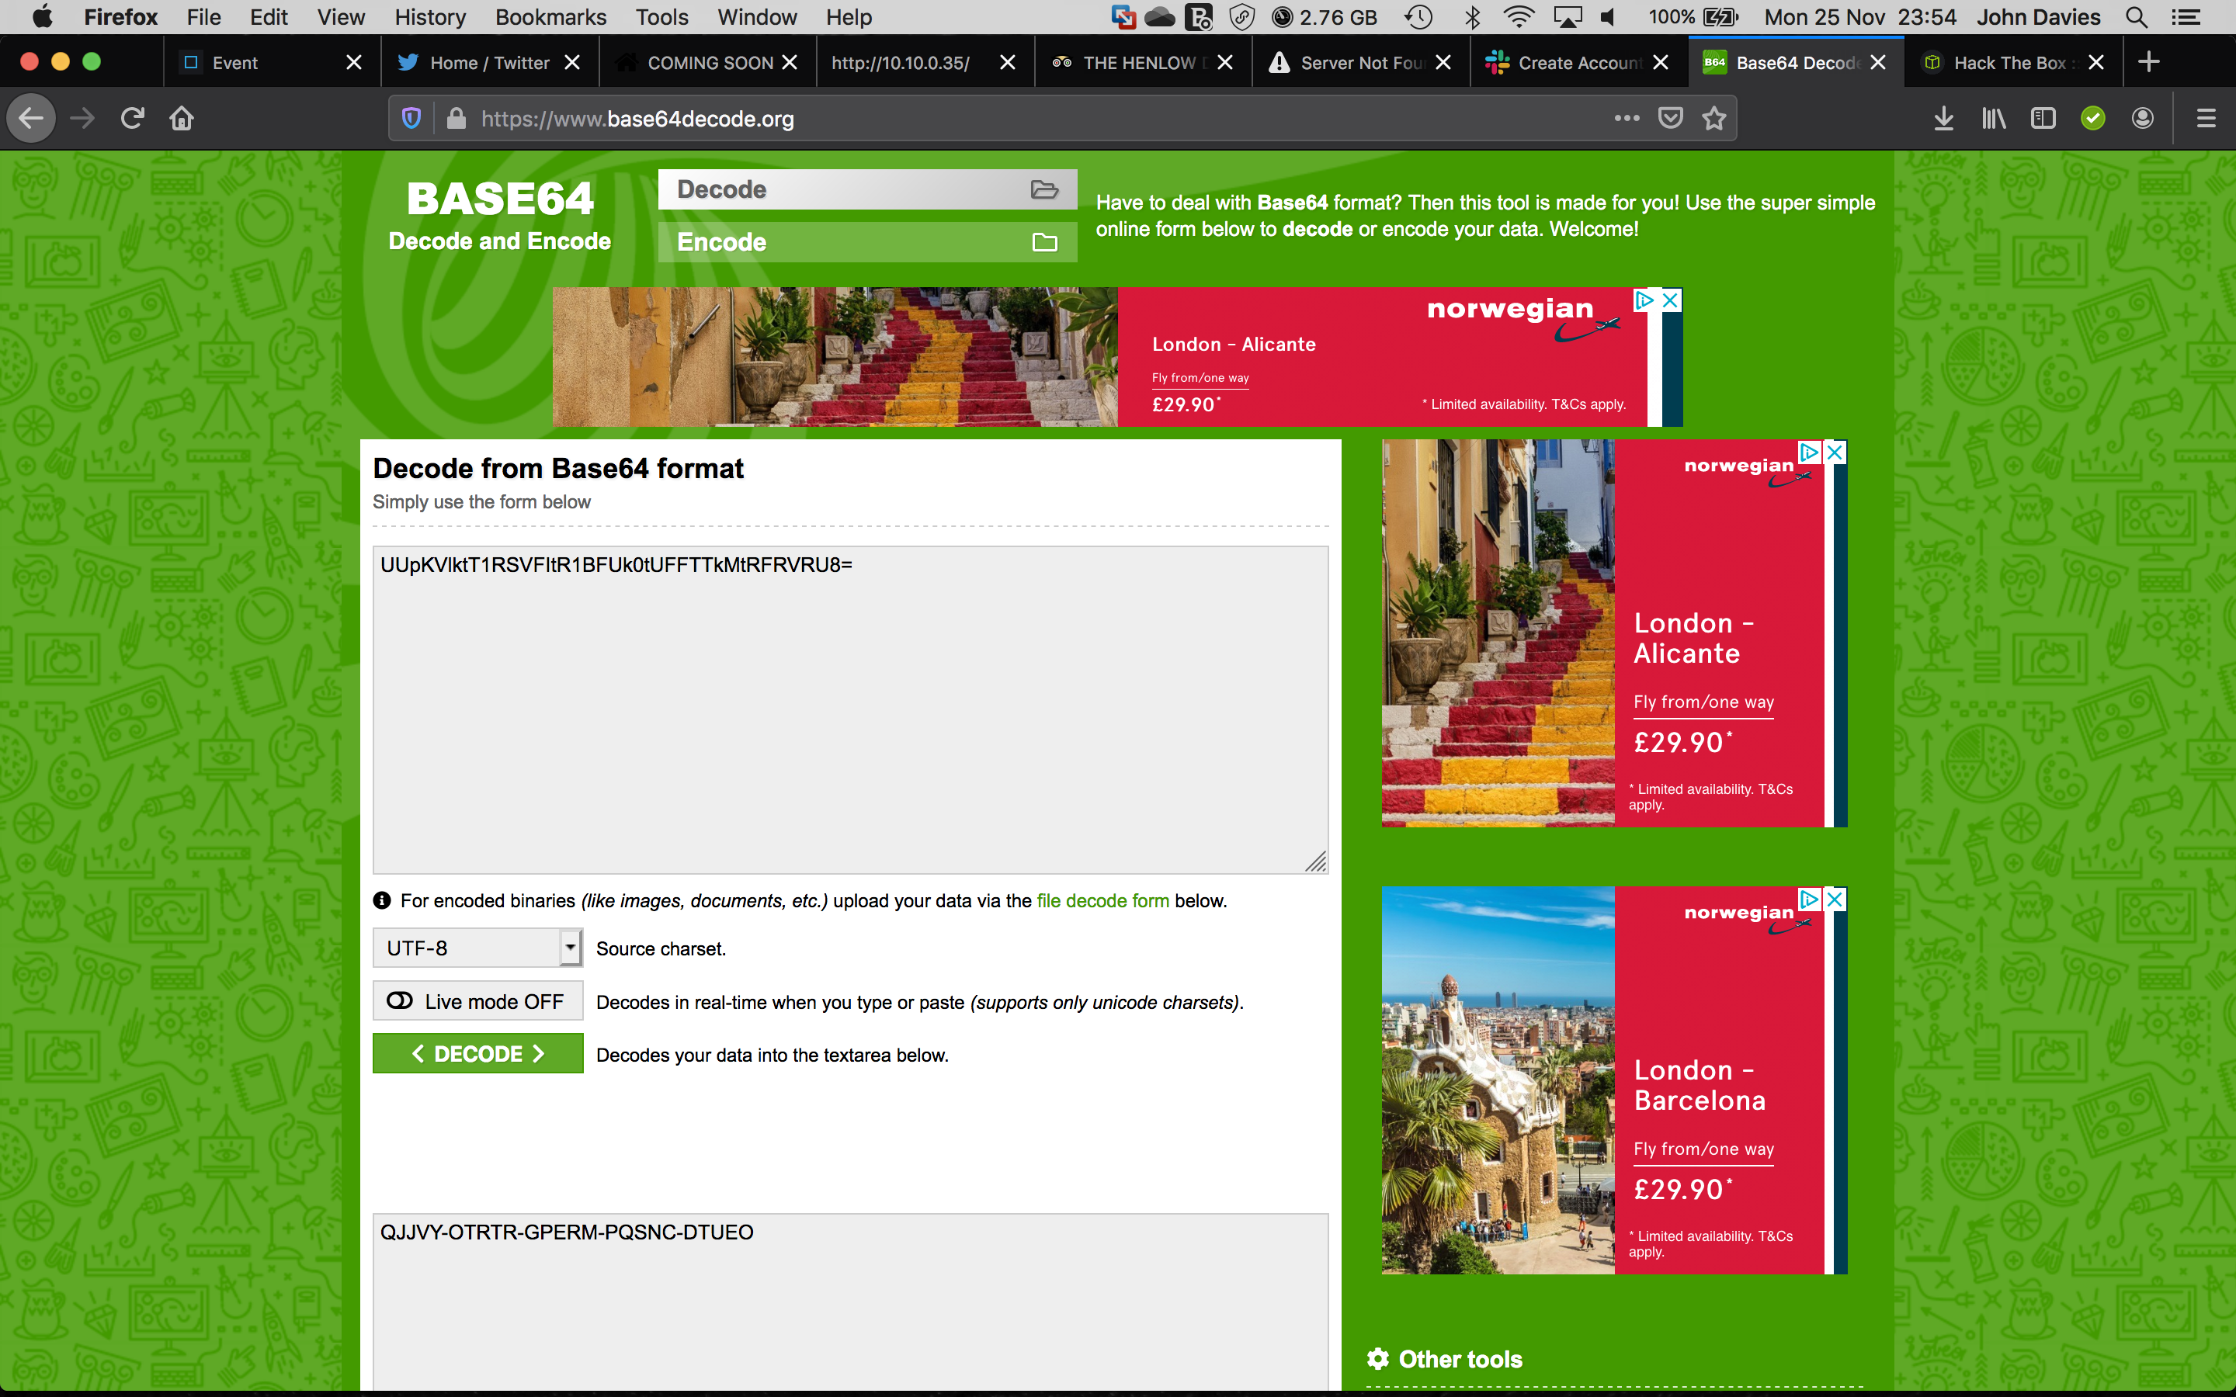
Still no need to reinvent the wheel
Enter encrypted
code here and
press ‘Decode’
Copy your invite
code and return
to hack the box
Supported by
Proud Supporters of

Slide 20
Finally… Let’s join the party!
QJJVY-OTRTR-GPERM-PQSNC-DTUEO
Paste the decrypted code here
Click Sign up
Supported by
Proud Supporters of

Slide 21
Finally… Let’s join the party!
Supported by
Proud Supporters of

Slide 22
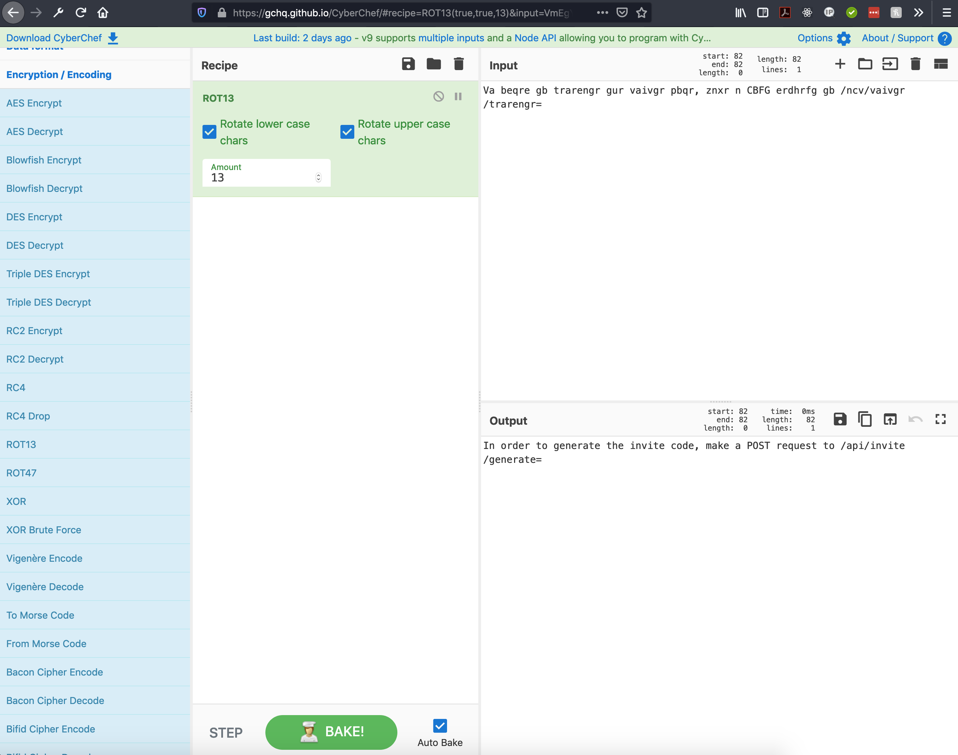
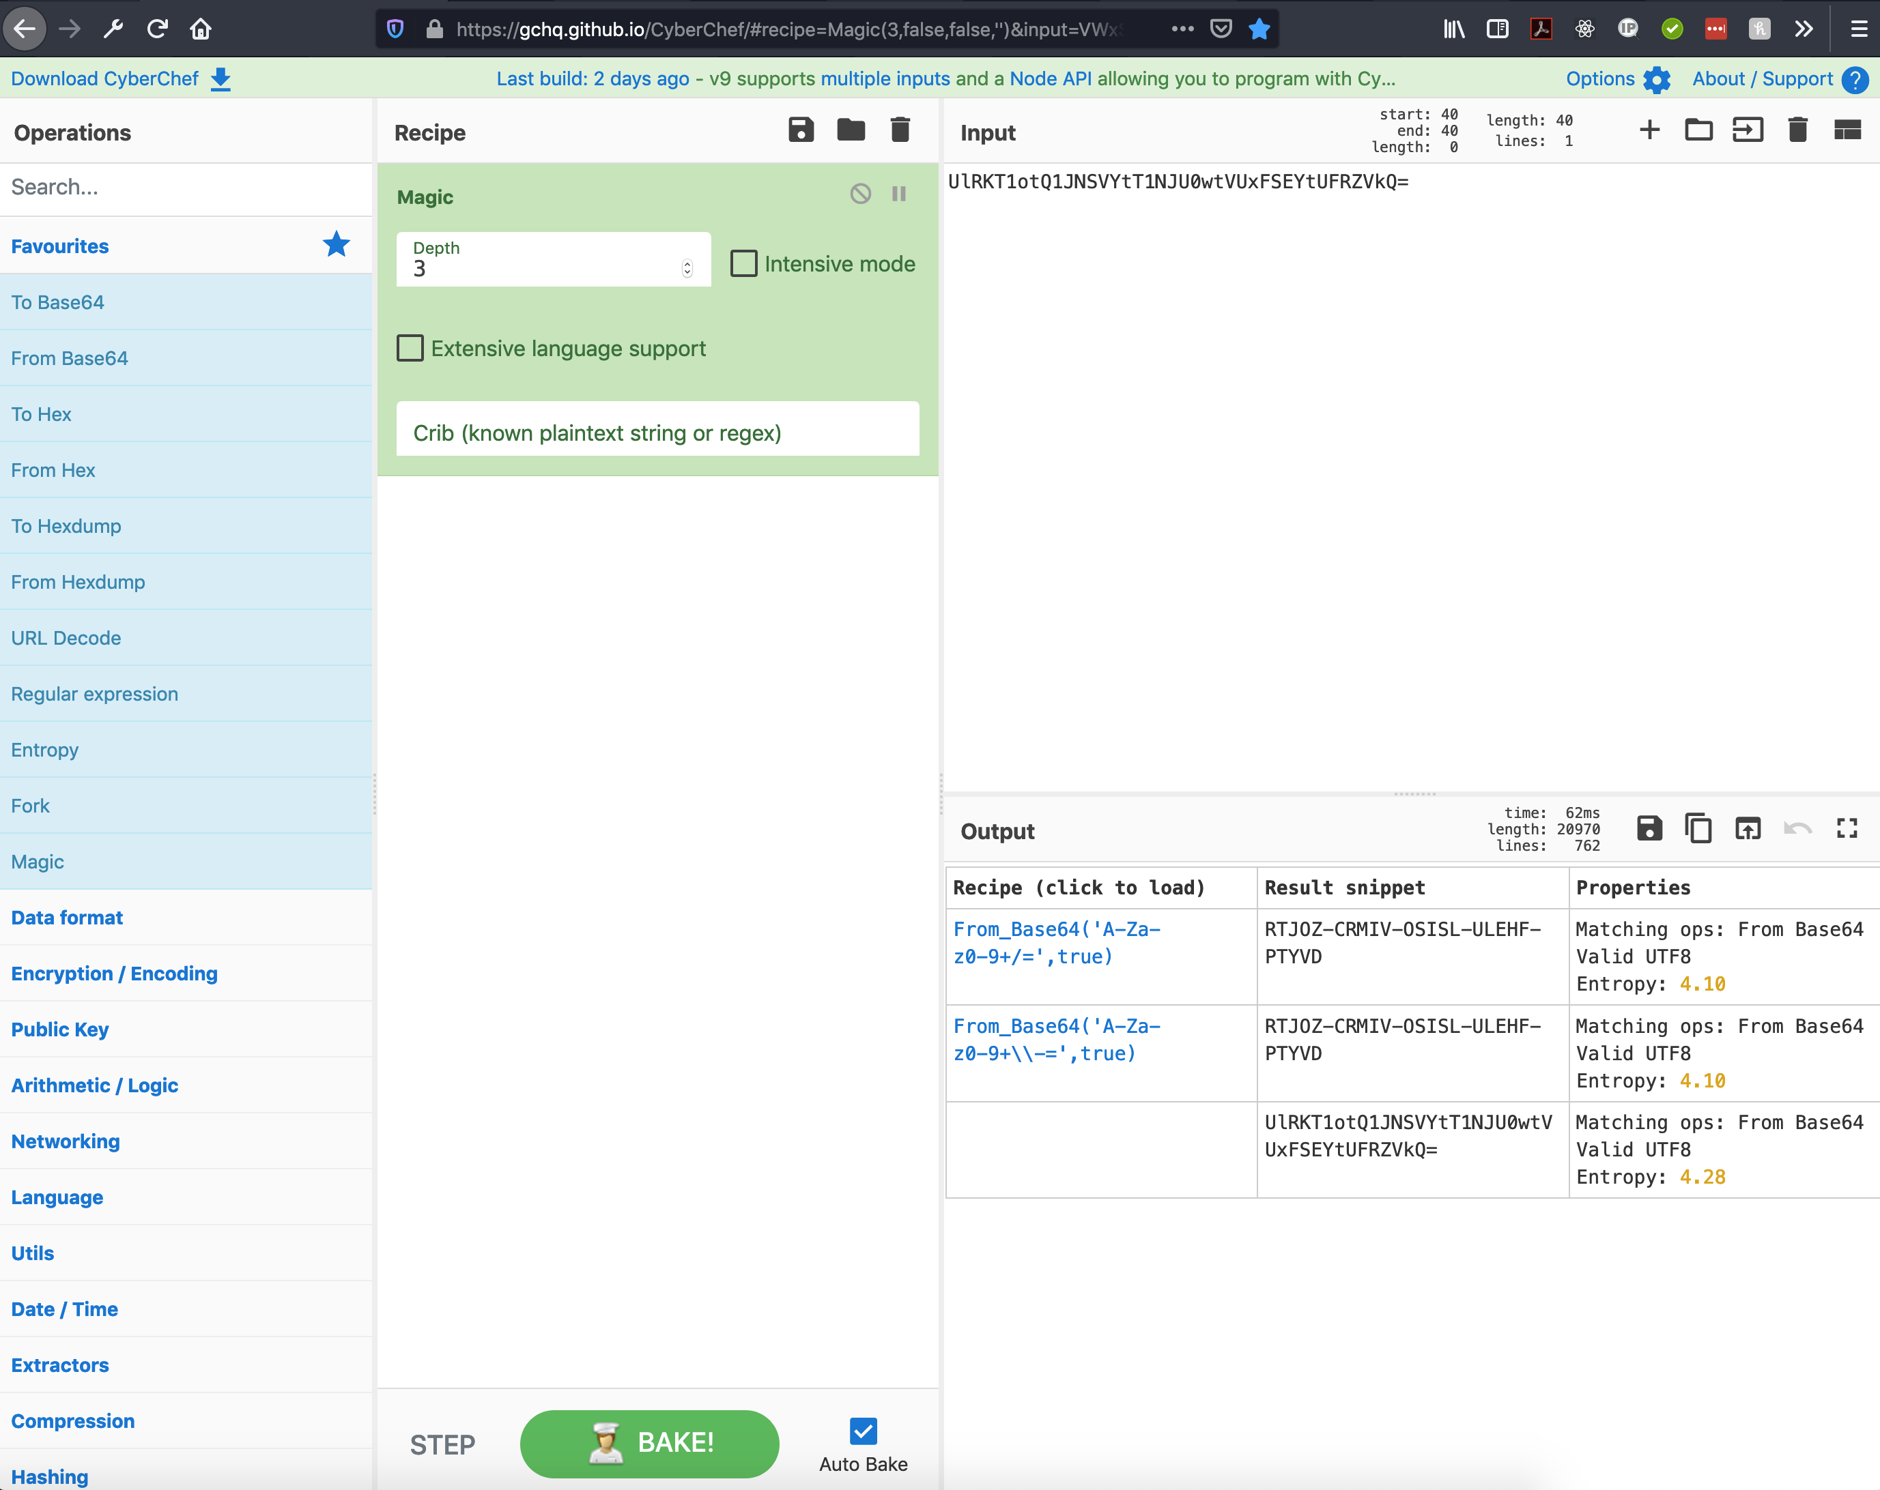
One tip for the future (save yourself some googling)
https://gchq.github.io/cyberchef
Supported by
Proud Supporters of

